Slide 1

6th Grade Accelerated Math
Unit 5, Lesson 11 Solving Problems Involving Ratios Volume 1, pg. 224

Slide 2


Benchmark
MA.6.AR.3.5
Solve mathematical and real-world problems involving ratios, rates, and unit rates, including comparisons, mixtures, ratios of lengths and conversions within the same measurement system.
volume 1, pg. 224

Slide 3
Integrated Mathematical Thinking and Reasoning Standards
MA.K12.MTR.4.1 Engage in discussions that reflect on the mathematical thinking of self and others.
MA.K12.MTR.7.1 Apply mathematics to real-world contexts.
volume 1, pg. 224

Slide 4

Learning Target
I can solve problems involving ratios, rates, and unit rates.
volume 1, pg. 224

Slide 5

Warm-Up
volume 1, pg. 225

Slide 6
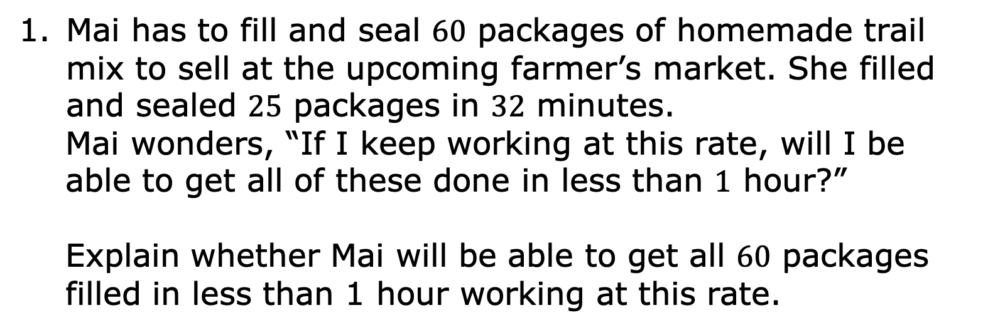
5.11.1 Warm-Up: Bell Work
Mai has to fill and seal $60$ packages of homemade trail mix to sell at the upcoming farmer’s market. She filled and sealed $25$ packages in $32$ minutes.
Mai wonders, “If I keep working at this rate, will I be able to get all of these done in less than $1$ hour?”
Explain whether Mai will be able to get all $60$ packages filled in less than 1 hour working at this rate.
volume 1, pg. 225

Slide 7

Activity
volume 1, pg. 225

Slide 8
5.11.2 Activity: Station 1: Is It a Deal?
Your teacher will give you a set of cards showing different offers.
Find card A and work with your partner to decide whether the offer on card A is a good deal. Explain or show your reasoning in the space provided.
volume 1, pg. 225

Slide 9
Next, split cards B–E so you and your partner each have two cards.
Decide individually if your two cards are good deals. Explain your reasoning for your two cards in the table.
Is the new deal a good deal?
Card B | Card C | Card D | Card E
volume 1, pg. 226

Slide 10
For each of your cards, explain to your partner if you think it is a good deal and why.
Listen to your partner’s explanations for their cards. If you disagree, explain your thinking. Write your partner’s explanation for their cards in the table above, after resolving any differences.
Revise any decisions about your cards based on the feedback from your partner.
volume 1, pg. 226

Slide 11
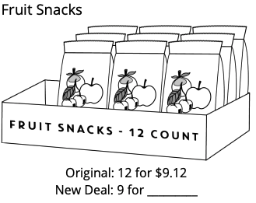
When you and your partner are in agreement about cards B–E, place all the cards you think are a good deal in one stack, and all the cards you think are a bad deal in another stack.
Another potential deal is shown.
volume 1, pg. 226

Slide 12
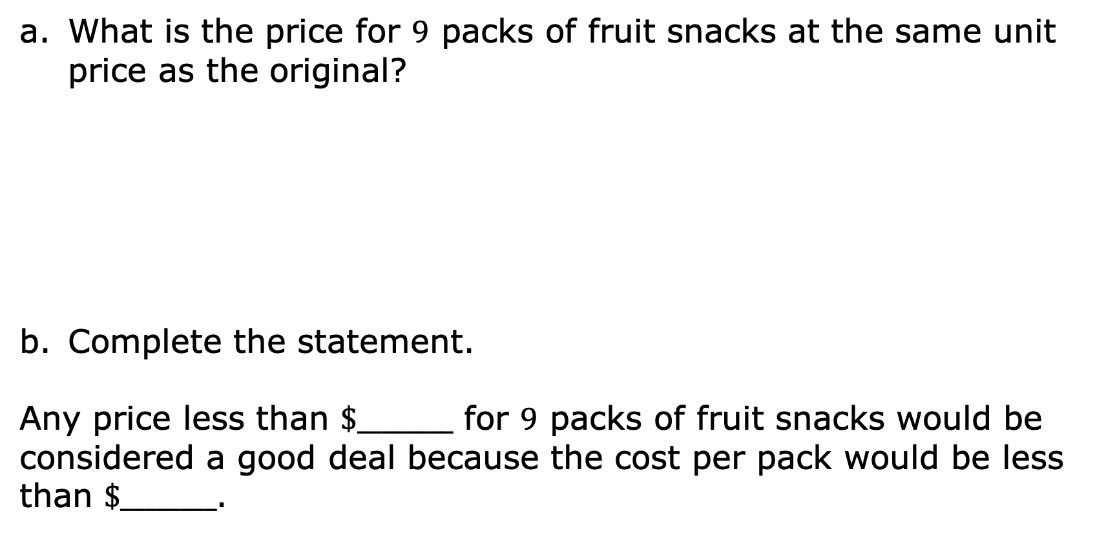
What is the price for $9$ packs of fruit snacks at the same unit price as the original?
Complete the statement.
Any price less than $\$________$ for $9$ packs of fruit snacks would be considered a good deal because the cost per pack would be less than $\$________$.
volume 1, pg. 226

Slide 13
Activity
volume 1, pg. 227

Slide 14
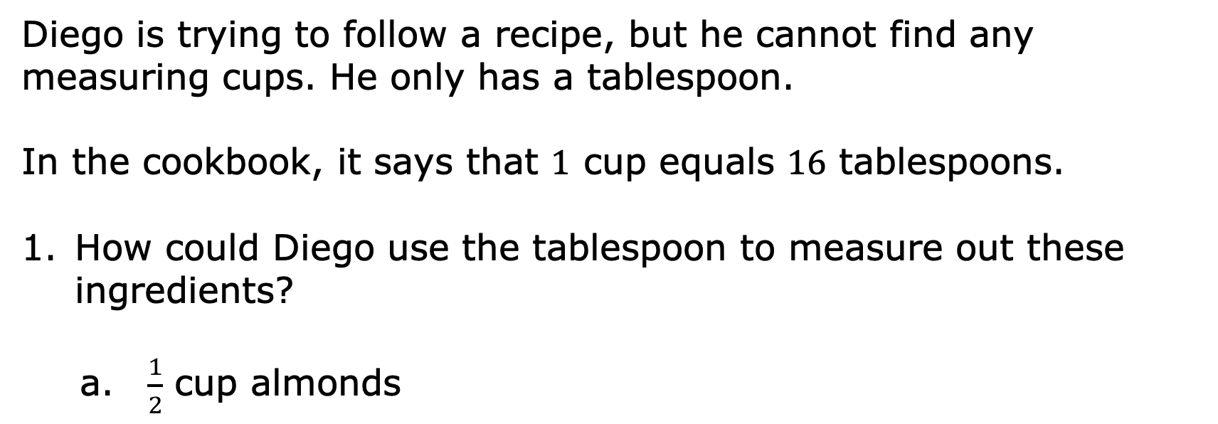
5.11.3 Activity: Station 2: Cooking with a Tablespoon
Diego is trying to follow a recipe, but he cannot find any measuring cups. He only has a tablespoon.
In the cookbook, it says that $1$ cup equals $16$ tablespoons.
How could Diego use the tablespoon to measure out these ingredients?
$\frac{1}{2}$ cup almonds
volume 1, pg. 227

Slide 15

$1\frac{1}{4}$ cup of oatmeal
$2\frac{3}{4}$ cup of flour
Diego also adds the following ingredients. How many cups of each did he use?
$28$ tablespoons of sugar
$6$ tablespoons of cocoa powder
volume 1, pg. 227

Slide 16
Activity
volume 1, pg. 227

Slide 17
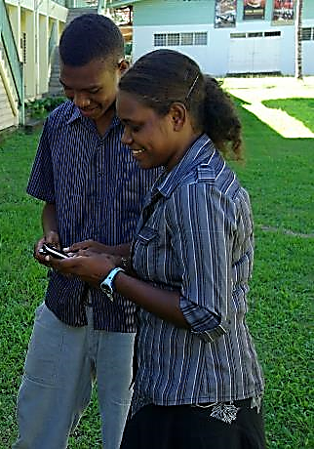
5.11.4 Activity: Station 3: Turbo Texting
Jonah was with his friend Erin after school and he needed to text his mom. Erin watched Jonah text and commented on how slow he was.
They decided to have a text race to determine who was faster. The image below shows what each person texted in the race.
I am the fastest texter!!! You are so slow! You will never beat me!
Think so? You’re about to lose this! It’s on!!
volume 1, pg. 227

Slide 18
Discuss any initial observations with your partner.
volume 1, pg. 227

Slide 19
Erin was able to send her text slightly faster than Jonah. Explain if you think this means she is the faster texter.
Describe the relationship you notice between the number of characters in a text versus how long it might take to type it.
What additional information would be helpful to determine who is the faster texter?
volume 1, pg. 228

Slide 20

The image below gives additional information about each person’s text.
I am the fastest texter!!! You are so slow! You will never beat me!
67 characters
7.4 seconds
Think so? You’re about to lose this! It’s on!!
46 characters
6.5 seconds
volume 1, pg. 228

Slide 21
Work with your partner or small group to determine who is the faster texter, using your preferred strategy. Show your work.
Jonah and Erin decided to send one last text to see who could send it out faster. The image shows the text they each sent.
154 characters
So let’s settle this once and for all. I am a way faster texter and there is nothing you can do about it. I am the GOAT and you’ll never catch me! I won!!
So let’s settle this once and for all. I am a way faster texter and there is nothing you can do about it. I am the GOAT and you’ll never catch me! I won!!
volume 1, pg. 228

Slide 22
If both people sent the message above at the same rate as before, predict about how many seconds it took each person to text the message to the nearest tenth of a second. Show your work.
Person | Predicted Time
Jonah
Erin
volume 1, pg. 228

Slide 23

Wrap-Up
volume 1, pg. 229

Slide 24
5.11.5 Wrap-Up: Reflection
Complete the learning period based on today’s lesson.
One question I would like to have answered …
One mistake I learned from today …
One thing I am not sure about … YET!
One thing I am confident I know is …
volume 1, pg. 229

